Slide 1
Software Reverse Engineering
Module F1 – Non-Binary SRE
Notes:
This slide deck is part of Software Reverse Engineering.
The context of this slide deck in shown below.
Part 0 – SRE in Context
Part A – SRE Prerequisites
Module A1: x86 and x64 Architectures and Assembly Languages
Module A2: ARM Architectures and Assembly Languages
Module A3: Forward Engineering
Part B – Philosophical Approaches to SRE
Module B1: Approaches to SRE
Part C – Static Analysis for Binary SRE
Module C1: File Handling Techniques
Module C2: Basic Static Analysis Tools
Module C3: Disassemblers and Decompilers
Part D – Dynamic Analysis for Binary SRE
Module D1: Sandboxing and Other Techniques
Module D2: Basic Dynamic Analysis Tools
Module D3: Debuggers
** Module D4: Network Traffic Analysis
Module D5: Patched Binaries
Part E – Obfuscation and Anti-SRE
Module E1: Obfuscation and Anti-SRE
Part F – Non-Binary SRE
Module F1: Non-Binary SRE

Slide 2
Table of Contents
Introduction
Web Pages
Other Formats
Summary
Notes:
These are the topics that are covered in this lesson.

Slide 3
Module F1 – Learning Objectives
Upon successful completion of this module, the student should be able to:
Describe and discuss other types of reverse engineering beyond compiled binaries.
Explain how embedded functionality can be found in a variety of formats that may seem benign at a superficial level.
Notes:
These are the learning objectives for Module A1 – x86 and x64 Architectures and Assembly Languages
These learning objectives are assessed through the following methods:
ASKs: There are questions in the note sections for the instructor to involve the students in the lesson and assess their grasp of the concepts.
LABs: There are lab exercises associated with this lesson

Slide 4
Introduction
Notes:
These are the topics that are covered in this lesson.

Slide 5
Non-Binary RE Examples
Binaries are not the only thing we may want or need to reverse engineer
Web pages
Documents
Media content (e.g., Flash)
Firmware Images
…
Notes:
Goal of RE is to gain insight into the functionality of something
Software binaries are probably the most obvious example, particularly for security related tasks like SRE for malware samples.
However, we often have other complex digital files that we may want to RE in order to discern their functionality or intent
Web page are often built from a set of components (HTML, Javascript, CSS, ...) that together define the intended content, layout, and functionality of a page. All of this is typically provided in text format (i.e., it is not a complied binary) but often (intentionally or unintentionally) the functionality or intent cannot be easily discerned
Document formats (e.g., MS Office formats, or PDF documents). Documents can have embedded script (macros or Javascript, for example) that can perform activities that we may want to understand
Media files (e.g., Adobe Flash). Again, while it is easy to think of these are visual media, they files can contain complex instruction sequences (scripts) whose functionality and intent we may want to discern.
Firmware images (can be binaries, but often compressed file system contents that contain a wide variety of files)
…

Slide 6
Web Pages
Notes:
These are the topics that are covered in this lesson.

Slide 7
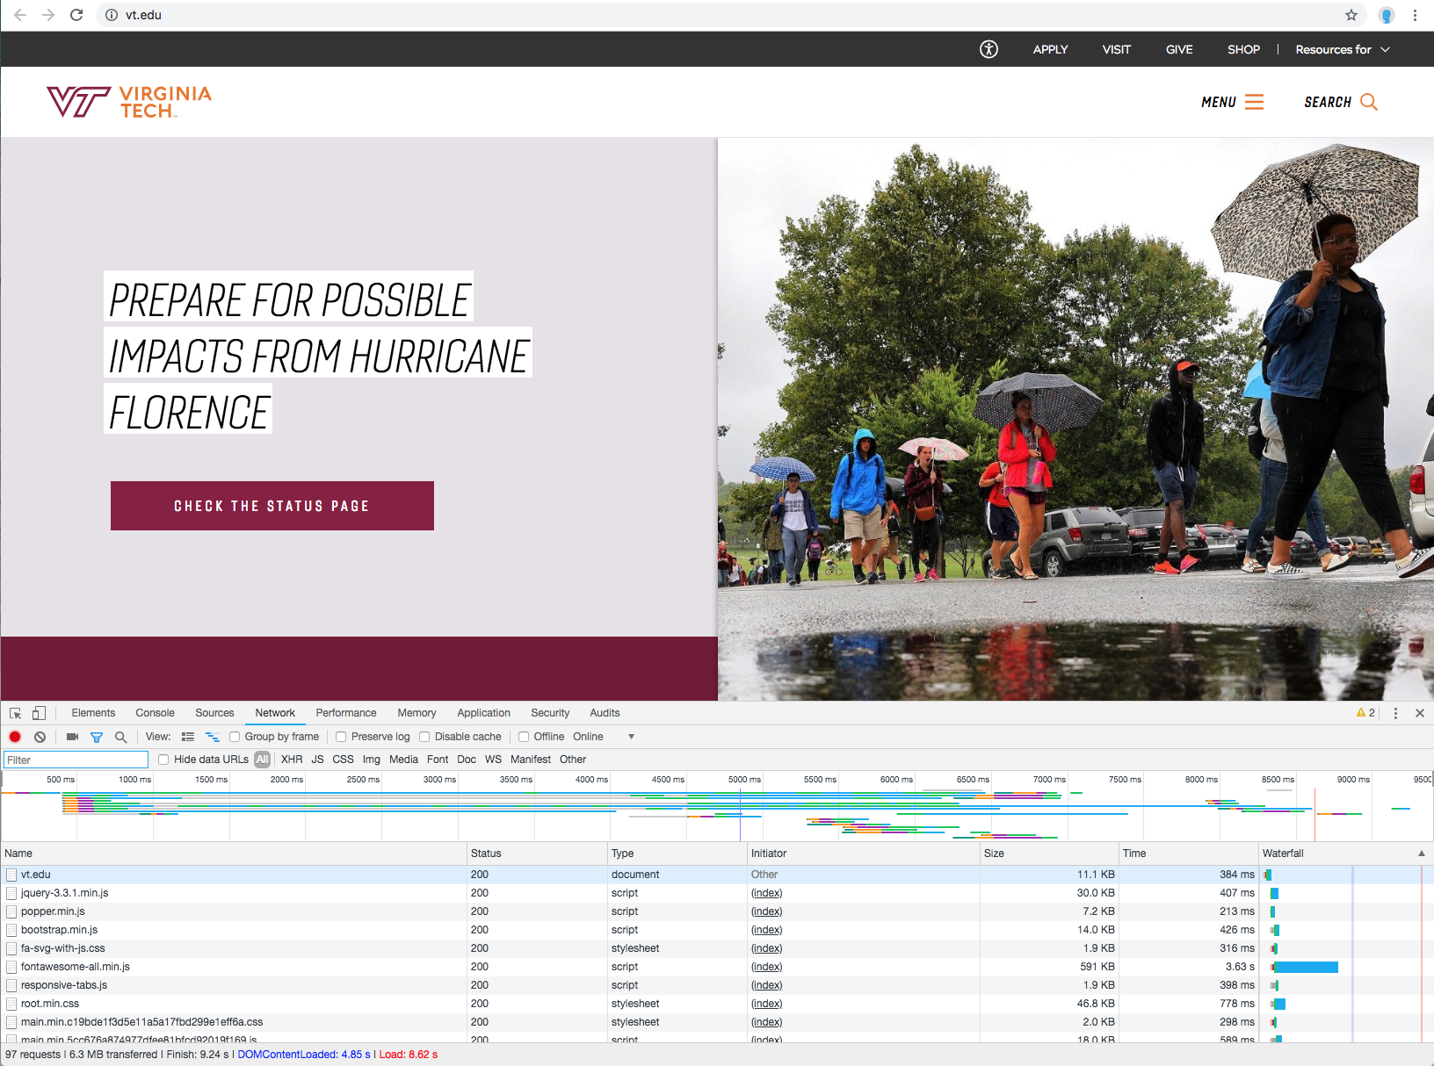
Web Pages 1
Notes:
Historically a single file (*.html) loaded from the filesystem of the webserver with some included references to images
Now each “page” is usually built in the browser from multiple files (typically at least html, css, and javascript files). It’s common for these pieces to come from a variety of sources for a single page
Using the inspect capability in each modern browser we can see the components loaded for a given page. In this example, https://www.vt.edu resulted in 97 requests, and loaded 6.3MB of data.
Exercise – try this for at least a couple of sites on your own (try your school’s website, for example). Most browsers will allow you to create a second profile in which you can clear the history before making the request, ensuring that all requests are served from the server instead of the browser’s local cache.
Were all of the requests made to the server you initially contacted? If not, what other servers were requests made to? What types of content was loaded?
In the case of the VT page, 21 of the 97 requests were for JavaScript (*.js) files, from a variety of sources. Some were from vt.edu (e.g., https://vt.edu/local_assets/www.assets.cms.vt.edu/jquery/archives/jquery-3.3.1.min.js)), but some were from other sources (e.g., https://www.google-analytics.com/analytics.js). The page also made 4 asynchronous request for data (XHR), in this case at the end of the page load process
Content for sites is also often served from a content distribution network (CDN) like Cloudflare or Akamai (so even though the request appears to be made to vt.edu, the actual content is served by a CDN host closer to the client, resulting in faster page loads and reduced load on the vt.edu server).
The point here is while a webpage was originally a fairly simple thing where HTML was served by the server to the client, the reality of the web today is that almost any page is a complex combination of a large amount of data, media, and scripting served by a wide variety of entities.
So how do we answer questions like ”What happens when I go to page X”, or “what information does page X send to what entities?”

Slide 8
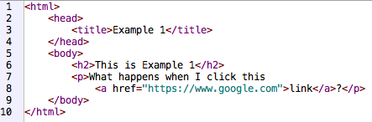
Example 1
Notes:
Here is a very simple HTML page (example1.html) which you can load into your browser

Slide 9
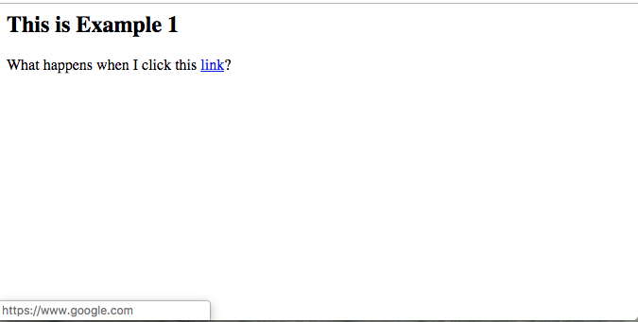
Example 1 (cont.)
Notes:
The HTML is rendered into a page like this, and if we mouseover the link the browser reports the target page at the bottom (https://www.google.com). If we click the link, we actually browse (as expected) to the google homepage.

Slide 10
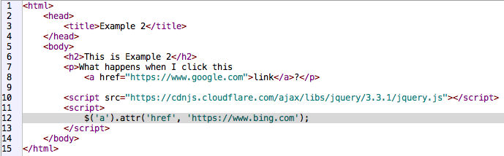
Example 2
Notes:
In this slightly more complex example, we first load jQuery (which is just a JavaScript library that gives easier access to perform common JS operations across various browsers), then on line 12 we modify the linked address for the link on line 8 so that it links to Bing instead of Google.

Slide 11

Example 2 (cont.)
Notes:
When we load this new page (example2.html) and mouseover the link, the status bar shows that it is now linked to https://www.bing.com, despite the HTML specifically pointing it to Google.

Slide 12
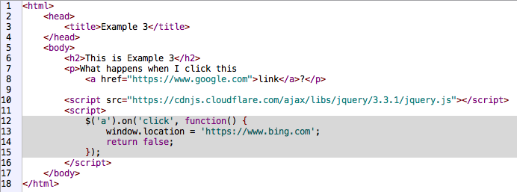
Example 3
Notes:
Now take a look at example 3, and see if you can determine a) what will be rendered in the browser, and b) what will happen when the link is clicked

Slide 13
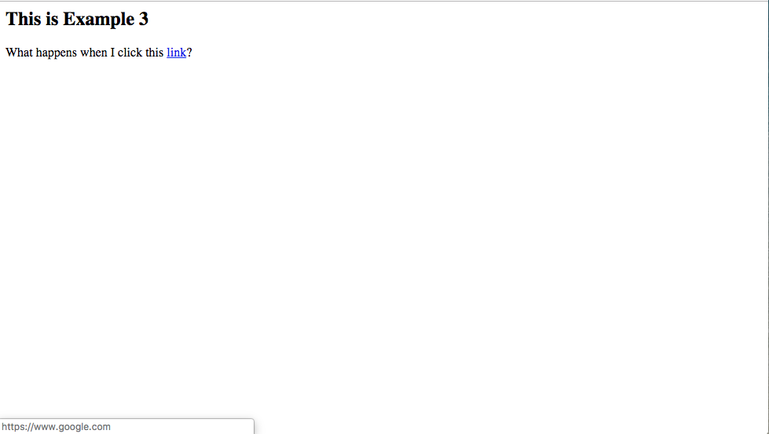
Example 3 (cont.)
Notes:
In this third simple example, the mouseover shows that the link is pointed at https://www.google.com. Is that what actually happens when we click the link?

Slide 14
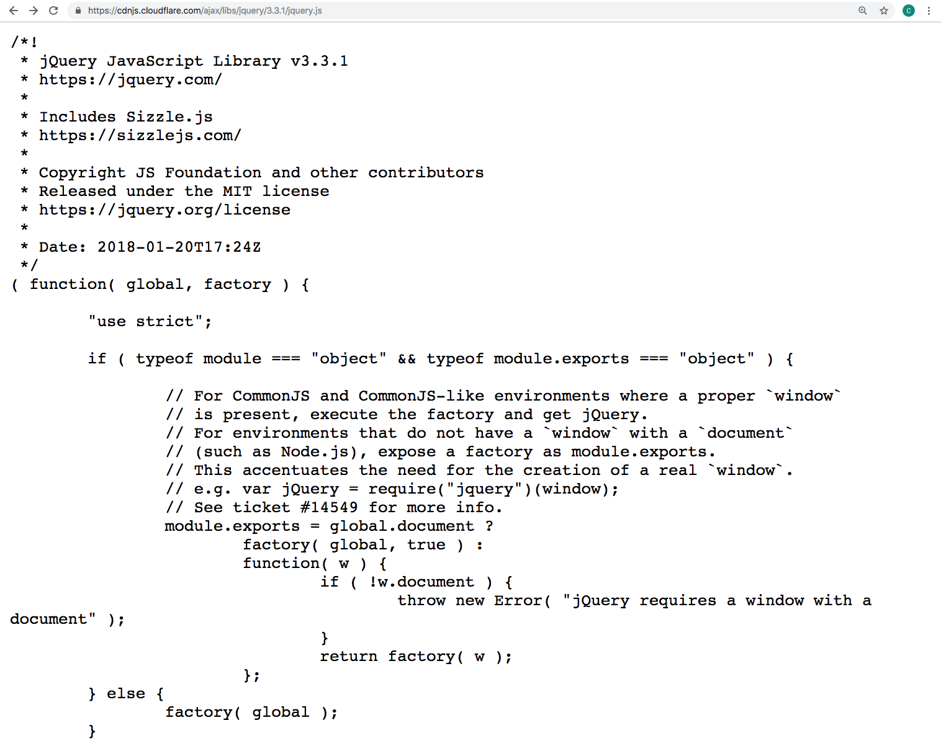
Minimized JS 1
Notes:
This is the start of the jQuery (version 3.3.1 in this case, downloaded from https://cdnjs.cloudflare.com/ajax/libs/jquery/3.3.1/jquery.js) JavaScript file. Although it is a large file, it is certainly readable code and includes comments.

Slide 15
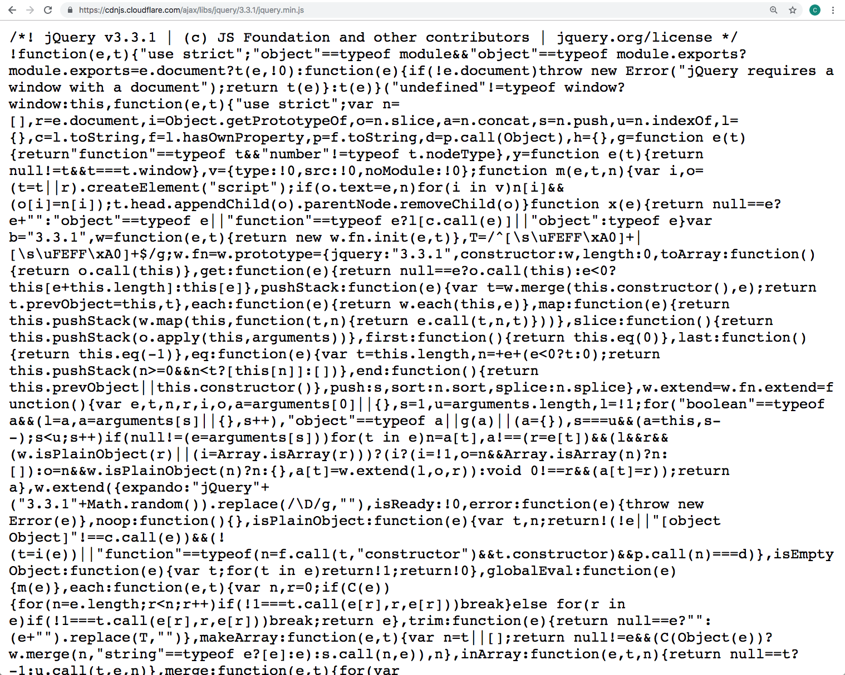
Minimized JS 2
Notes:
In most production environments, JavaScript in minimized in order to reduce the download size. Almost all comments are stripped, function and variable names are simplified, and the code is generally written without newlines or the typical formatting that a human programmer would expect to see in source code. This slide shows the same jQuery version as the previous slide (v.3.3.1 from https://cdnjs.cloudflare.com/ajax/libs/jquery/3.3.1/jquery.min.js) in minified form.
While development tools allow web developers to minimize JavaScript for deployment in production, many CDNs also automatically minify javascript prior to delivery to the end client (the browser), so even JavaScript that the developer has not minified can arrive at the browser in minifed format.

Slide 16
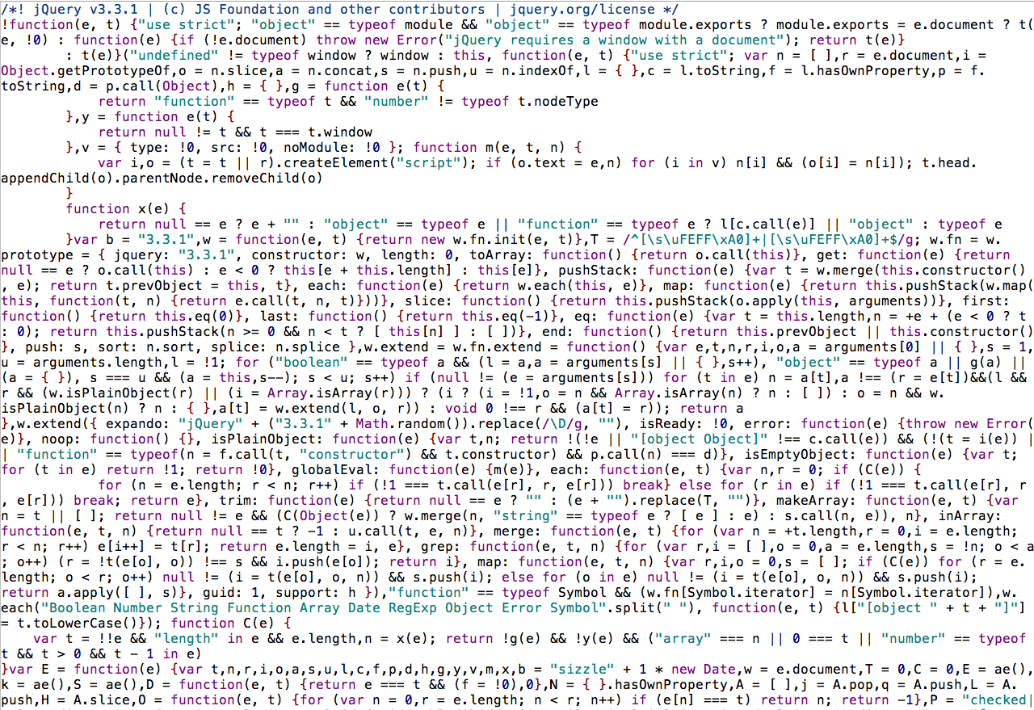
Minimized JS 3
Notes:
We can use tools to recover some of the structure of the original un-minified file, but much of the information that can be useful to humans (comments and meaningful variable and function names) are of course not recovered. As a result, un-minified JS is somewhat similar to de-compiled C code – you can recover some of the structure, but much of the information that human programmers use to discern intent is irretrievably lost in the process. For example, a function called toLowerCase() could reasonably be expected to convert a string to lower case. The un-minified (or decompiled) code would be unlikely to give the function such a meaningful name.

Slide 17
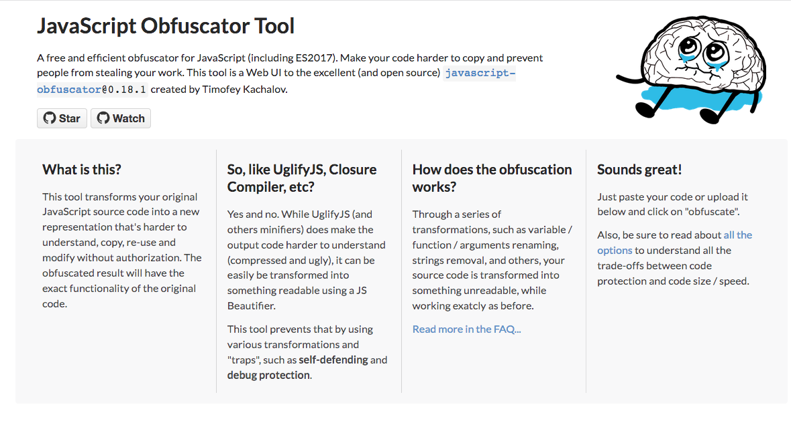
JS Obfuscation
Notes:
JavaScript obfuscators (like this web GUI found at https://obfuscator.io/, or the underlying utility found at https://github.com/javascript-obfuscator/javascript-obfuscator) go well beyond minifiying JavaScript, and make the resulting JS code challenging to reverse engineer.
Have a look through and discuss some of the obfuscations that this tool is capable of performing
Open example 4 (in which the JavaScript has been obfuscated using this tool) and see if you can determine what will happen when the link is clicked.

Slide 18
Other Formats
Office Documents
PDF Documents
Various media formats (e.g., Flash with ActionScript)
Firmware images
…
Notes:
Office documents – macros in VBA are the best known, but external functions in DLL can be accessed, as can data sources (e.g., local or remote databases) and external hosts (e.g., network resources). Programming embedded in office documents can be heavily obfuscated, quickly reach into truly compiled external code, and has the ability to communicate with local and remote services and hosts. Essentially this is a fully functional programming environment, and once “macros” are allowed to execute, the “document” has wide-reaching abilities to perform operations that few would consider to be reasonable or expected for a “document” to perform.
PDF documents allow a wide variety of media types to be embedded (each of which may included it’s own embedded functionality). Javascript code can also be embedded in a PDF document also.
Firmware images are often the mechanism by which embedded systems or IoT devices are updated. Often the updates are entire filesystem contents compressed and potentially encrypted into a single image, which the device can then decompress and re-flash a storage device with. Understanding the intent of a firmware update, or even getting to the point that the image has been decompressed can be challenging. Tools like binwalk can provide help in this type of work.

Slide 19
Summary
RE is not just limited to reversing compiled binaries.
Many other file types/formats contain or reference code that can perform wide-ranging actions, the intent of which can be difficult to discern.

